Slide 1
Maths Daily Practice
Grade 1 - Weeks 3 & 4
Unit 1.3
Complete this work in a notebook at home. This is not mandatory homework.
Therefore, it does not need bringing into school. This is optional practice to support the learning taking place in school.

Slide 2
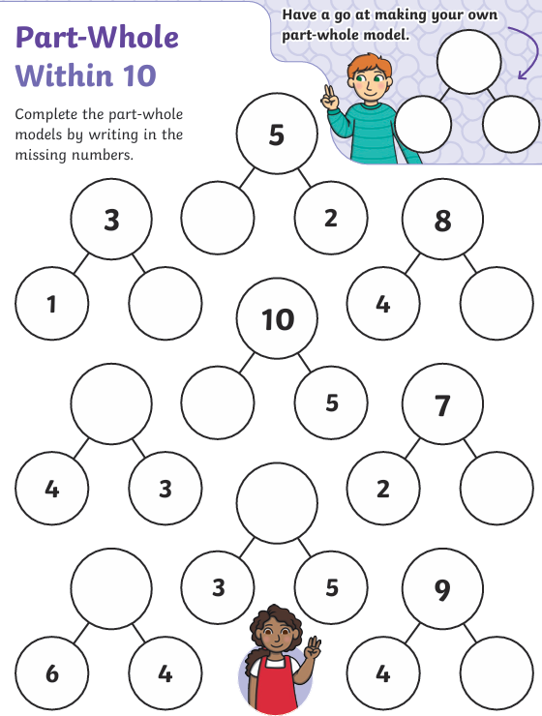
Daily practice 1
Number bonds up to 10
Complete the part-whole models by writing the correct numbers in the spaces.
Building fluency and speed of number bonds up to 10 will benefit your child’s mathematical ability throughout many key areas.

Slide 3
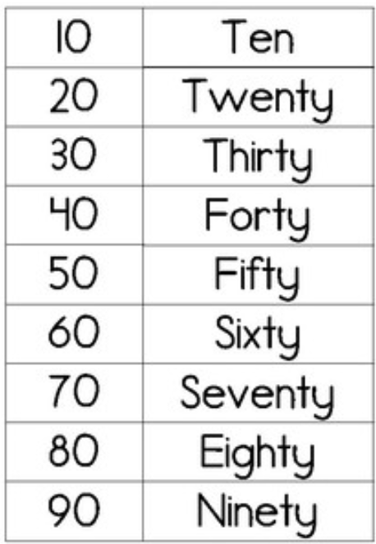
Daily practice 2
Number spelling
Many numbers do not follow simple phonetic rules. Therefore, students must practice and remember how to spell the tens times table numbers.
Practice writing these numbers and then test your child to see if they can remember their spellings without looking.

Slide 4
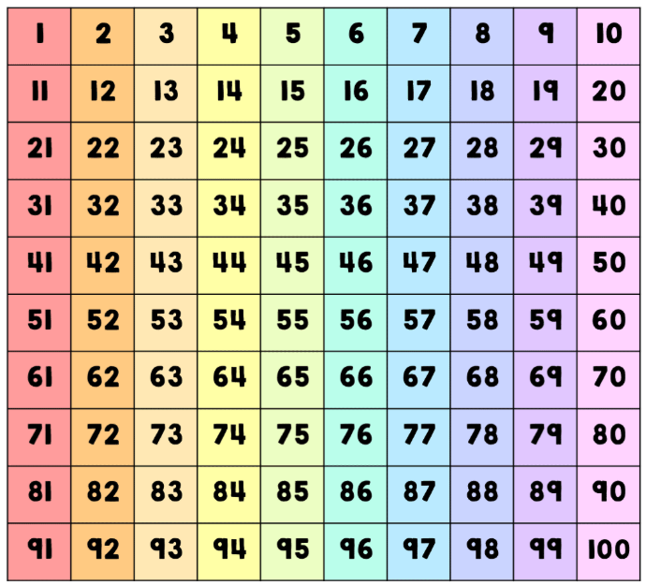
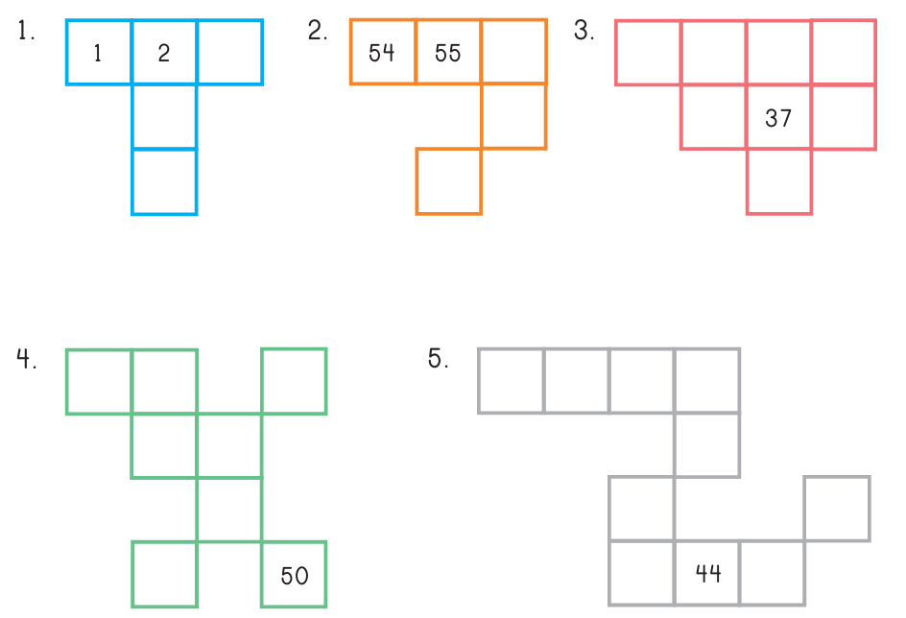
Daily practice 3
Place Value
Use a 100s grid and place value understanding to find the missing numbers.

Slide 5
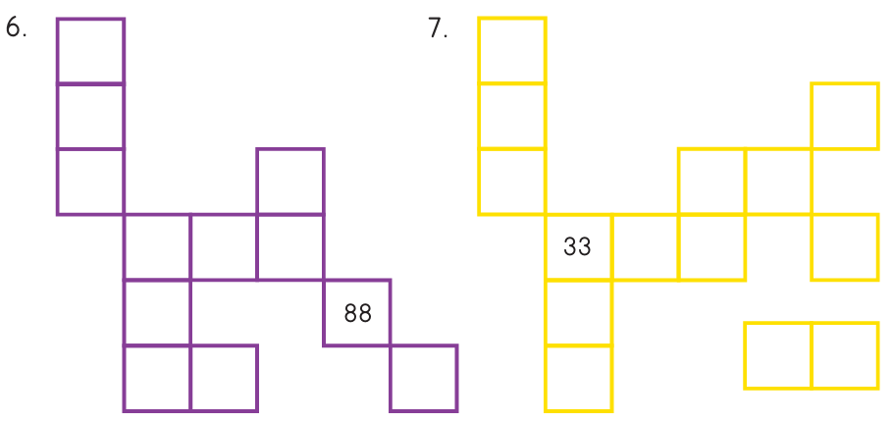
Daily practice 4
Place Value
Use a 100s grid and place value understanding to find the missing numbers.

Slide 6
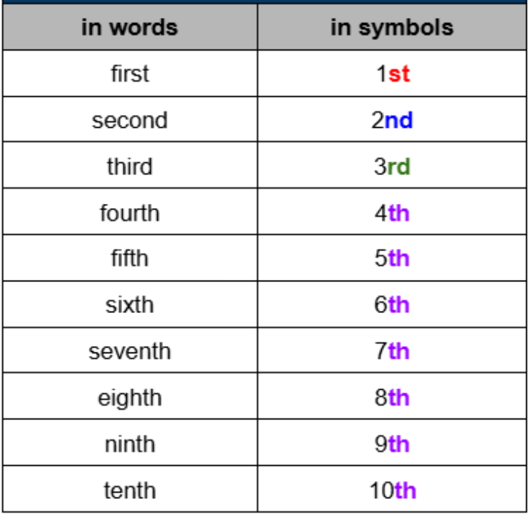
Daily practice 5
Ordinal Number
Spelling
Notice that the use of either: st, nd, rd, th
Depends on the last two letters of the word.

Slide 7
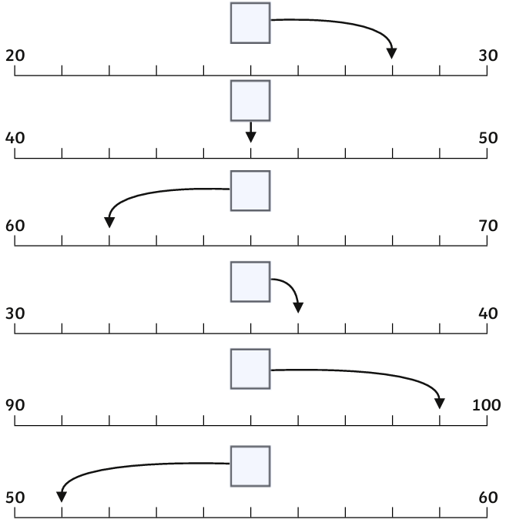
Daily practice 6
Using a number line
Use your understanding of counting in 1s to place the numbers onto their correct position on the number lines.

Slide 8
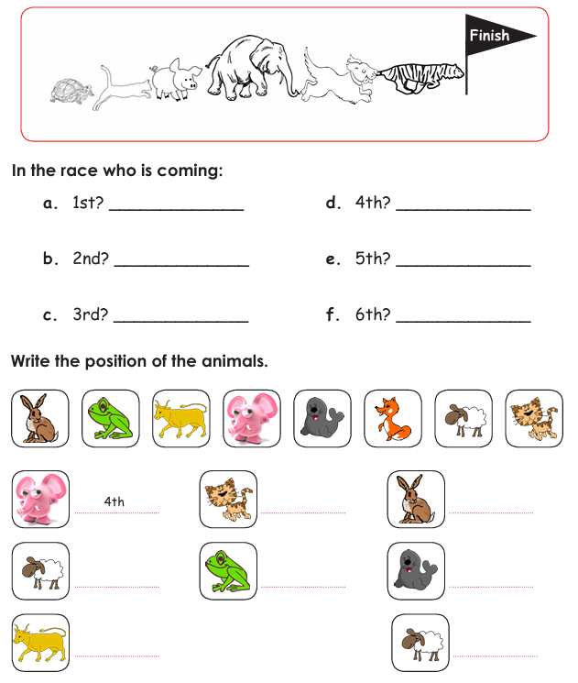
Daily practice 7
Ordinal Numbers
Find ordinal numbers and label ordinal numbers.

